Slide 1
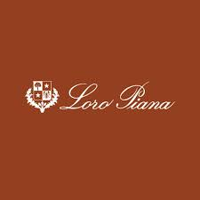
Web presence project Crafting & Compelling Website Analysis, Audit and Recommendations presented by,
G . Kiruthik Chakra | BADM-WD-T-B9

Slide 2
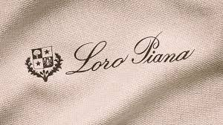
Company Selection:
I selected the company “Loro Piana” for this Web Presence Project.
About Loro Piana:
Founded in 1924 in Quarona, Italy, Loro Piana is a luxury textile brand with a rich heritage.
Specializes in producing the finest natural fibers, including cashmere, merino wool, and rare materials like baby cashmere and vicuña.
Known for exceptional craftsmanship, blending traditional techniques with modern innovations.
Offers a range of premium products such as clothing, accessories, and home textiles, all emphasizing understated elegance.

Slide 3
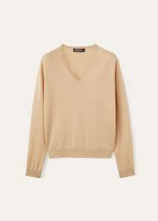
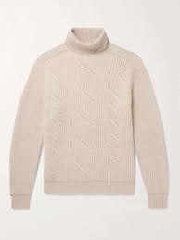
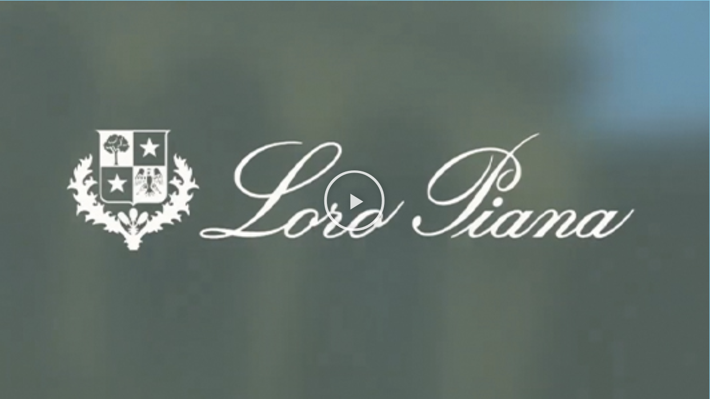
Product and Service Descriptions:
1.Cashmere Sweaters
Made from the finest, hand-selected cashmere fibers for a luxurious feel.
Extremely soft, lightweight, and warm, perfect for layering or wearing on their own.
Timeless and versatile designs, suitable for both casual and formal occasions.
Available in a wide range of colors, from neutrals to vibrant tones.
Handcrafted with meticulous attention to detail, ensuring durability and longevity.

Slide 4
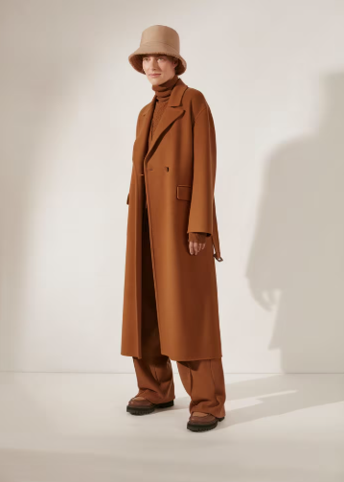

2.Vicuña Coats
Crafted from the rare and incredibly soft vicuña wool, known for its lightweight warmth.
Highly exclusive, as vicuña is one of the most expensive fibers in the world.
Elegant and timeless designs that elevate any winter wardrobe.
Provides unmatched insulation while being incredibly breathable.
Perfectly tailored to offer a sophisticated silhouette and a flawless fit.

Slide 5
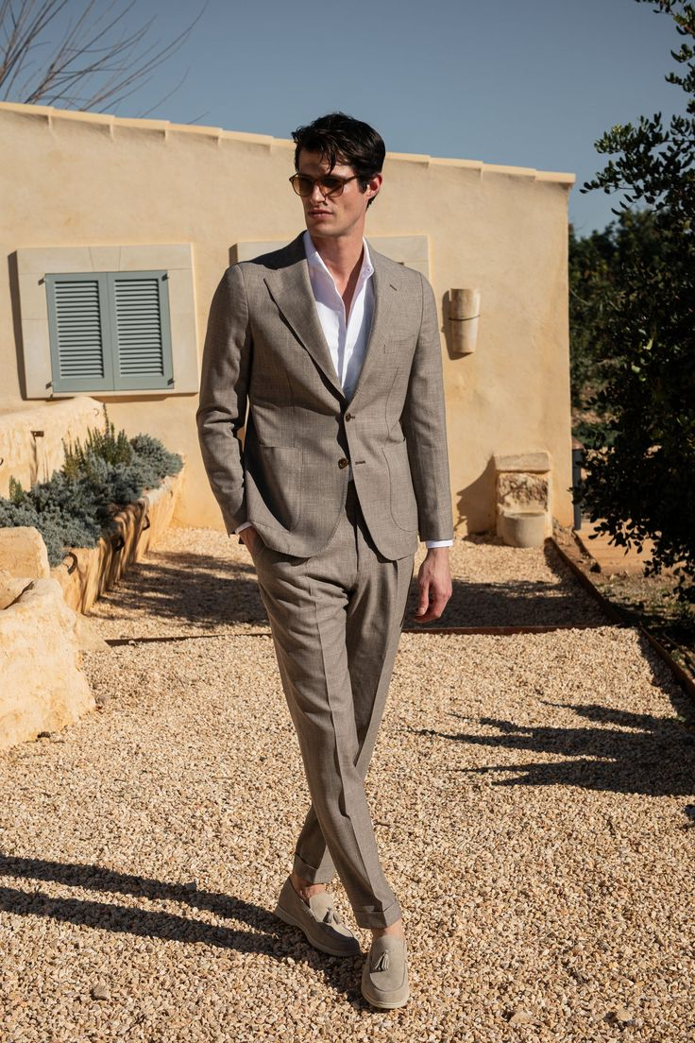
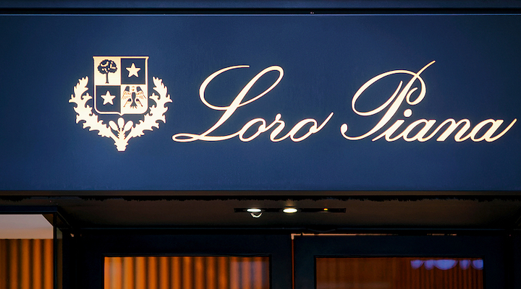
3.Merino Wool Suits
Made from ultra-fine merino wool, offering breathability and lightweight comfort.
Designed for both elegance and functionality, suitable for year-round wear.
The fabric’s natural stretch provides ease of movement, perfect for daily wear.
Precision tailoring ensures a sharp, sophisticated fit that enhances the wearer’s shape.
Available in classic colors, ideal for professional and formal occasions.

Slide 6
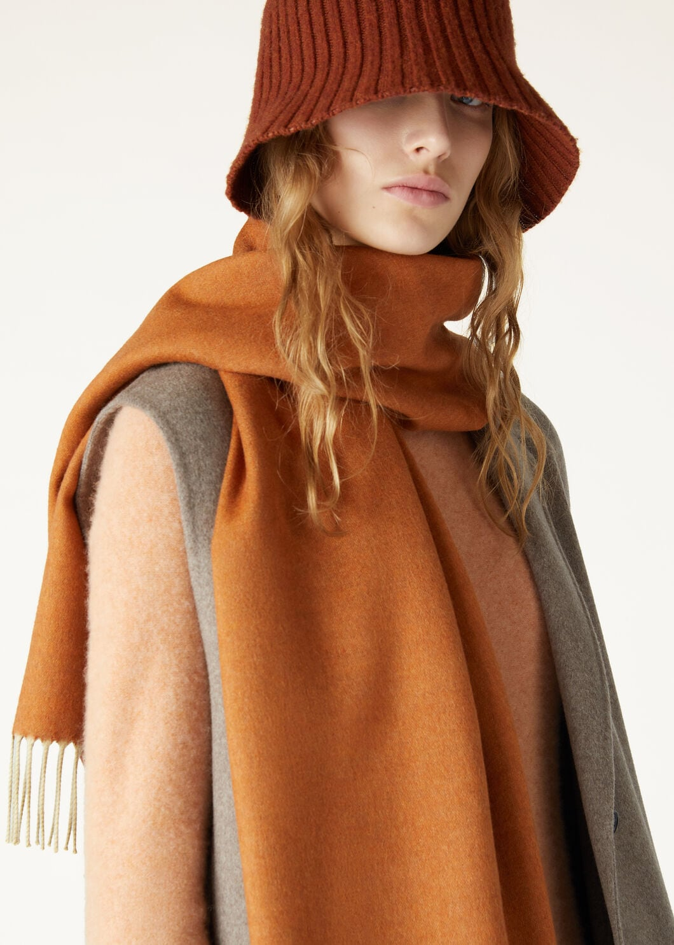
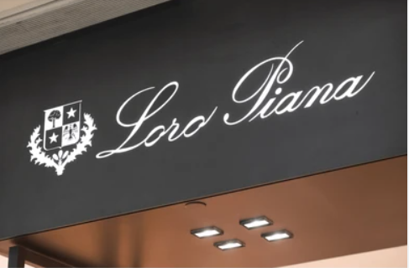
4.Baby Cashmere Scarves
Crafted from the softest cashmere fibers, harvested from the undercoat of young goats.
Luxuriously warm and lightweight, providing all-season comfort.
A timeless accessory that adds sophistication and elegance to any outfit.
Expertly woven to ensure a smooth, delicate texture against the skin.
Available in a variety of colors and styles, from subtle neutrals to bolder shades.

Slide 7
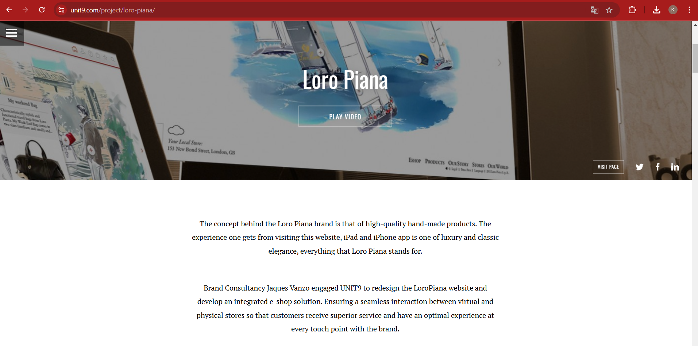
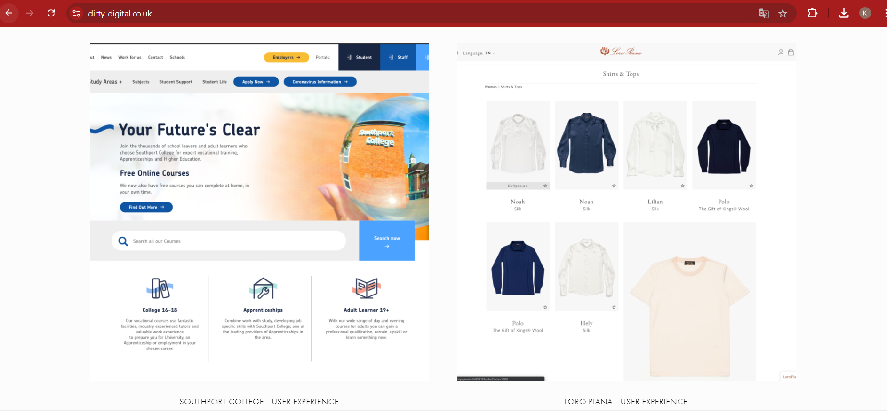
Website Platform Identification:
Platform: The website is developed by UNIT 9 and Dirty Digital , identified using with ChatGPT, google and unit9 website and Dirty Digital website.
Design and User Experience:
UNIT9 spearheaded the redesign, emphasizing a seamless interaction between the website and physical stores. This included integrating stock management and CRM systems to provide a unified e-commerce experience​UNIT9.
The website features immersive product presentations, such as interactive scenes and videos, showcasing products within their ideal contexts, such as yacht regattas and exclusive events​UNIT9 ,​dirty digital.
These are the websites used for identify the “loro Piana” website developed https://www.unit9.com/project/loro-piana/ and https://www.dirty-digital.co.uk/ and following example of screenshots also showed in this slide.

Slide 8

Responsive Design Testing:
Tools Used: Google Mobile-Friendly Test, GTmetrix, and Browser Stack.
Report:
Navigation and User Experience: users find the navigation slightly unintuitive.
Mobile Responsiveness: While the site generally adapts well to mobile devices, certain elements, like dropdown menus or interactive features, may not function optimally on all devices or browsers​The VOU
Checkout and Payment Issues: Some users have noted occasional glitches during the checkout process, including delays in loading payment gateways or errors in applying promo codes​Highsnobiety.
Localization Issues: Switching between languages or regional settings (e.g., currency options) has been flagged as inconsistent or problematic in certain geographical versions of the site​Loro Piana
Checkout Process Glitches: Occasional problems during checkout, such as delays in loading payment pages, applying promo codes, or completing transactions, have been reported. These issues can lead to abandoned carts and user dissatisfaction​.

Slide 9
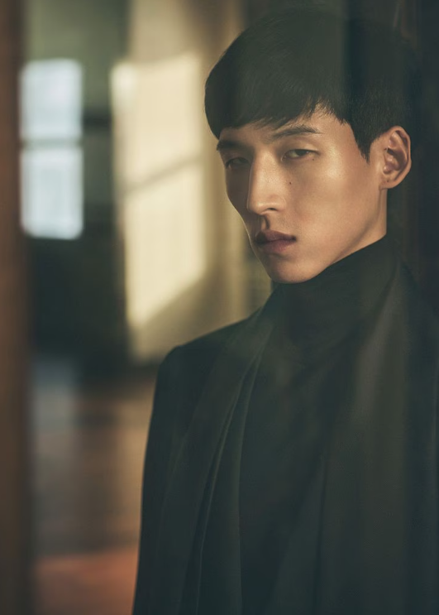
Website Mistakes Identification:
Suggestions to “Loro Piana” Website:
Conduct usability testing to refine navigation and address performance bottlenecks.
Optimize image sizes and implement adaptive content loading techniques.
Improve testing for mobile responsiveness across multiple device types and operating systems.
Regularly audit the checkout process to ensure smooth functionality.
Enhance accessibility features to align with WCAG standards.

Slide 10
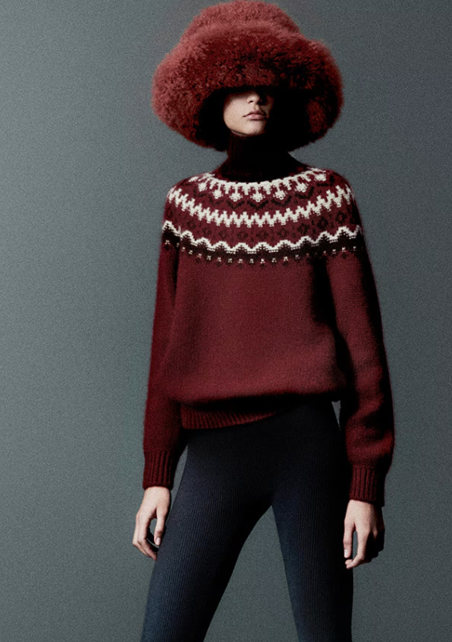
Website Best Practices List:
Maintain a consistent visual identity reflecting the brand's luxury ethos.
Use high-resolution visuals to showcase product craftsmanship and exclusivity.
Ensure a responsive design that adapts seamlessly across devices.
Implement well-structured navigation with intuitive filtering options.
Provide localized content with multi-language and currency support.
Integrate online and in-store inventory for real-time stock updates.

Slide 11
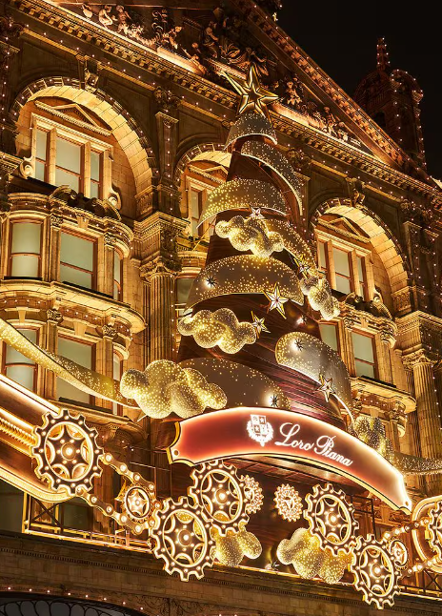
Landing Page Design:
Objective: Increasing Brand Awareness of old money Men's polo and T-shirts.
Design Features:
Product Imagery: High-quality, close-up images of the polo shirts, showcasing fabric texture, details, and available colors. Additional angles display the garments' fit and craftsmanship​.
Detailed Product Information: Descriptions highlight the unique materials like Wish® wool or "The Gift of Kings®" fabric, emphasizing their exclusivity and heritage. Specifications include care instructions and model measurements to aid customer decisions.
Interactive Elements: Options to select sizes, check in-store availability, and view a size guide ensure user-friendly navigation and convenience​.
Luxury Branding: Use of subtle animations and clean layouts with neutral tones aligns with Loro Piana's luxury brand image.
Sustainability Notes: Mentions of environmentally responsible packaging reflect the brand's commitment to sustainability​.

Slide 12
Landing Page Design:
Landing page design - https://https-loropiana-mens-polotshirts.my.canva.site/loro-piana-old-money-tshirts

Slide 13
Conclusion:
This project has successfully demonstrated the essential aspects of digital marketing and website design, focusing on creating a compelling and user-friendly online presence for Loro Piana.
By understanding the fundamentals of digital marketing, identifying key design principles, and applying best practices.
I have crafted a landing page that effectively showcases Loro Piana Men's Polo T-shirts, aiming to generate leads and enhance brand awareness.
The actionable insights and design recommendations provided will contribute to the continuous improvement and optimization of Loro Piana digital presence.

